Slide 1

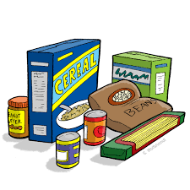

Wear What You Like Day
On Tuesday 25TH March The Community Crew would like to invite pupils to wear their own clothes in return for donations for the school Food Bank
We are grateful for any donations, however, to make sure we can replenish what we are currently low on these are suggested items for each year group:
Reception: Rice/Pasta
Year 1: Tinned meat and meals e.g., curry, bolognaise, sausages
Year 2: Cereals, and cereal bars
Year 3: Squash and Long Life Milk
Year 4: Jars of pasta sauce, tinned tomatoes and vegetables
Year 5: Tinned rice, custard or fruit
Year 6: Biscuits or crackers

